Slide 1



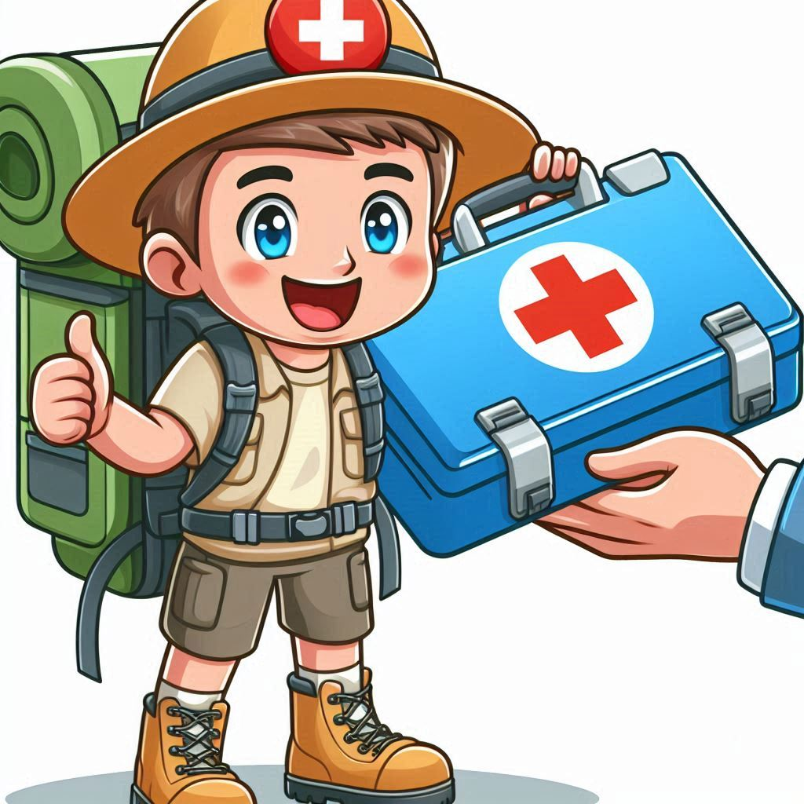


Ultralight
The Cook
Speedy
Not an ounce extra…
Perform any physical feat - 10 push-ups, 10 lunges, stop a go-back action
Outdoor Gourmet…
Mime making food, if the team guesses the food in one min, add one Croo
No one can keep up …
hum a song, if team guesses in one min or less - stop a go-back action
Medic
All the Gear
Storyteller
Ready for action…
whistle a song, if team guesses in one min or less - stop a croo loss
Is that a puppy in your bag?
impersonate a person using gear, the team guesses the gear - stop croo loss
Keeping Sprits high
Tell a short story.
Add one Croo

Slide 2
Croo Member
Croo Member
Croo Member
Croo Member
Croo Member
Croo Member

Slide 3
Ask the croo this question, they have 30 seconds to agree on an answer.
Ask the croo this question, they have 30 seconds to agree on an answer.
Ask the croo this question, they have 30 seconds to agree on an answer.
Q: Name the Ten Essentials
Q: What is a map bearing?
Q: What is a field bearing?
Navigation
Sun Protection
Insulation
Illumination
First-Aid Supplies
Fire Starter
Repair Kit/Tools
Nutrition
Hydration
Emergency Shelter
Finding a bearing using your location (your rear), and the destination. By orienting with the north-south lines with the north south lines on the map.
In navigation, field bearing is the horizontal angle between the direction of an object and north.
Correct Answer: Move any Croo Member one space forward
Correct Answer: Move any Croo Member one space forward
Correct Answer: Move any Croo Member one space forward
Ask the croo this question, they have 30 seconds to agree on an answer.
Ask the croo this question, they have 30 seconds to agree on an answer.
Ask the croo this question, they have 30 seconds to agree on an answer.
Q: What is the meaning of leave no trace?
Q: What is the rotating black ring on your compass called?
Q: What is magnetic declination on a map?
minimizing your impact on the environment while enjoying the outdoors, ensuring natural spaces remain pristine for future generations
Bezel
The difference in degrees between true north and magnetic north
Correct Answer: Move any Croo Member one space forward
Correct Answer: Move any Croo Member one space forward
Correct Answer: Move any Croo Member one space forward

Slide 4
Croo Challenge
Croo Challenge
Croo Challenge
Croo Challenge
Croo Challenge
Croo Challenge

Slide 5
Ask the croo this question, they have 30 seconds to agree on an answer.
Ask the croo this question, they have 30 seconds to agree on an answer.
Ask the croo this question, they have 30 seconds to agree on an answer.
Q: What is the arrow at the top of your compass called
Q: What do tight topographical lines on a map mean?
Q: What do wide lines on a topographical map mean?
Direction of travel arrow
Steep terrain
Less Steep terrain
Correct Answer: Move any Croo Member one space forward
Correct Answer: Move any Croo Member one space forward
Correct Answer: Move any Croo Member one space forward
Ask the croo this question, they have 30 seconds to agree on an answer.
Ask the croo this question, they have 30 seconds to agree on an answer.
Ask the croo this question, they have 30 seconds to agree on an answer.
Q: Does an large blank area between topographical lines mean flat ground?
Q: Name 2 of 3 stove types
Q: True or False – Isobutane works better in cold weather
No just that any variation doesn’t exceed the scale of the topographical map
Canister (iso butane)
Liquid fuel (white gas)
Alternate-fuel
False, you need to keep your gas warm
Correct Answer: Move any Croo Member one space forward
Correct Answer: Move any Croo Member one space forward
Correct Answer: Move any Croo Member one space forward

Slide 6
Croo Challenge
Croo Challenge
Croo Challenge
Croo Challenge
Croo Challenge
Croo Challenge

Slide 7
Ask the croo this question, they have 30 seconds to agree on an answer.
Ask the croo this question, they have 30 seconds to agree on an answer.
Ask the croo this question, they have 30 seconds to agree on an answer.
Q: What is a good starting estimate for calories per day?
Q: Do you need more or less calories in cold weather? How muych
Q What are options to keep food safe from Bears?
2500-3000 per day
You’ll need 500-1000 additional calories
Bear Cans
Bear Bags
Correct Answer: Move any Croo Member one space forward
Correct Answer: Move any Croo Member one space forward
Correct Answer: Move any Croo Member one space forward
Ask the croo this question, they have 30 seconds to agree on an answer.
Ask the croo this question, they have 30 seconds to agree on an answer.
Ask the croo this question, they have 30 seconds to agree on an answer.
Q: What are some cold weather dangers?
Q: True or false – Poinson oak has edible berries in the spring
Q: How much water should you plan per day of desert hiking?
Hypothermia
Frost Bite
Slipping on ice
Sunburn
False – don’t eat poison oak
½ quart to 1 quart of water per hour of hiking
Correct Answer: Move any Croo Member one space forward
Correct Answer: Move any Croo Member one space forward
Correct Answer: Move any Croo Member one space forward

Slide 8
Croo Challenge
Croo Challenge
Croo Challenge
Croo Challenge
Croo Challenge
Croo Challenge

Slide 9
Ask the croo this question, they have 30 seconds to agree on an answer.
Ask the croo this question, they have 30 seconds to agree on an answer.
Ask the croo this question, they have 30 seconds to agree on an answer.
Q: What are some symptoms of Altitude Sickness?
Q: What are the 7 principles of leave no trace
Q What are the three clothing layers?
symptoms - ○Headache○Tiredness○Lack of appetite○Nausea○Vomiting○Children may just seem fussy (This applies to adults too!)
Plan ahead and prepare
Travel and camp on durable surfaces
Dispose of waster properly
Leave what you find
Minimize campfire impacts
Respect wildlife
Be considerate of visitors
Base Layer
Insulation Layer
Shell Layer
Correct Answer: Move any Croo Member one space forward
Correct Answer: Move any Croo Member one space forward
Correct Answer: Move any Croo Member one space forward
Ask the croo this question, they have 30 seconds to agree on an answer.
Ask the croo this question, they have 30 seconds to agree on an answer.
Ask the croo this question, they have 30 seconds to agree on an answer.
Q: How do you prevent altitude sickness
Q: How do you prevent lightning danger
Q: What is the 45 degree rule as it relates to lightning
Acclimatize
Ascend slowly
Rest Days
Medication
Stay weather aware
Don’t be tall
Don’t be a conductor
Take shelter
You should stay away from tall objects like trees using a 45 degree angle from the top of the object as a measure
Correct Answer: Move any Croo Member one space forward
Correct Answer: Move any Croo Member one space forward
Correct Answer: Move any Croo Member one space forward

Slide 10
Croo Challenge
Croo Challenge
Croo Challenge
Croo Challenge
Croo Challenge
Croo Challenge

Slide 11
Ask the croo this question, they have 30 seconds to agree on an answer.
Ask the croo this question, they have 30 seconds to agree on an answer.
Ask the croo this question, they have 30 seconds to agree on an answer.
Q: Name some weather report sources
Q; Name two hiker apps and why they should not be depended upon
Q At night, what can you use to find your directions
NOAA
Weather Underground
Weather channel
Caltopo
Gaia GPS
Batteries die, Devices get damages
North Star
Correct Answer: Move any Croo Member one space forward
Correct Answer: Move any Croo Member one space forward
Correct Answer: Move any Croo Member one space forward
Ask the croo this question, they have 30 seconds to agree on an answer.
Ask the croo this question, they have 30 seconds to agree on an answer.
Ask the croo this question, they have 30 seconds to agree on an answer.
Q: What constellation can help find southerly direction at night
Q True or False – A think layer of cotton can keep you warm while hiking
Q: What kind of tent do you need when snow camping?
Orion
True until it gets wet, then very false
4-season
Correct Answer: Move any Croo Member one space forward
Correct Answer: Move any Croo Member one space forward
Correct Answer: Move any Croo Member one space forward

Slide 12
Croo Challenge
Croo Challenge
Croo Challenge
Croo Challenge
Croo Challenge
Croo Challenge

